Slide 1
Consolidation therapy with Blinatumomab improves overall survival in newly diagnosed adult patients with b-lineage acute lymphoblastic leukemia in measurable residual disease negative remission: Results from ecog-acrin e1910 randomized phase Iii national cooperative clinical trials network trial
Mark R Litzow¹, Zhuoxin Sun², Elisabeth Paietta³, Ryan J Mattison⁴, Hillard M Lazarus⁵, Jacob M Rowe⁶, Daniel A Arber⁷, Charles G Mullighan⁸, Cheryl L Willman⁹, Yanming Zhang¹⁰, Matthew Wieduwilt¹¹, Michaela Liedtke¹², Julie Bergeron¹³, Keith W Pratz¹⁴, Shira Dinner¹⁵, Noelle V Frey¹⁶, Steven D Gore¹⁷, Bhavana Bhatnagar¹⁸, Ehab L Atallah¹⁹, Geoffrey L Uy²⁰, Deepa Jeyakumar²¹, Tara L Lin²², Richard F Little²³, Selina M Luger²⁴, and Martin S Tallman²⁵
¹ Division of Hematology, Mayo Clinic, Rochester, MN; ² Dana-Farber Cancer Institute, Boston, MA; ³ Cancer Center, Montefiore Medical Center, Bronx, NY; ⁴ Carbone Comprehensive Cancer Center, Madison, WI
⁵ Adult Hematologic Malignancies & Stem Cell Transplant Section, University Hospitals Cleveland Medical Center, Shaker Heights, OH; ⁶ Department of Hematology, Shaare Zedek Medical Center, Jerusalem, Israel; ⁷ Department of Pathology, The University of Chicago, Chicago, IL; ⁸ Department of Pathology, St. Jude Children's Research Hospital, Memphis, TN; ⁹ Mayo Clinic, Rochester, MN; ¹⁰ Department of Pathology and Laboratory Medicine, Cytogenetics Laboratory, Memorial Sloan Kettering Cancer Center, New York, NY; ¹¹ Stephenson Cancer Center, University of Oklahoma Health Sciences Center, Oklahoma City, OK; ¹² Department of Medicine, Divisions of Oncology and Hematology, Stanford University, Stanford, CA; ¹³ CEMTL installation Maisonneuve-Rosemont, Montreal, QC, Canada; ¹⁴ Department of Medicine, Hematology-Oncology Section, Hospital of the University of Pennsylvania, Philadelphia, PA; ¹⁵ Robert H. Lurie Comprehensive Cancer Center, Northwestern University, Chicago, IL; ¹⁶ Abramson Cancer Center, University of Pennsylvania, Narberth, PA; ¹⁷ Cancer Therapy Evaluation Program, National Cancer Institute, Bethesda, MD; ¹⁸ Department of Hematology and Medical Oncology, West Virginia University Cancer Institute, Wheeling, WV; ¹⁹ Division of Hematology/Oncology, Medical College of Wisconsin, Milwaukee, WI; ²⁰ Division of Oncology, Department of Medicine, Washington University School of Medicine, Saint Louis, MO; ²¹ Division of Hematology/Oncology, UC Irvine Medical Center, Orange, CA; ²² University of Kansas, Westwood, KS; ²³ National Cancer Institute, Washington, DC; ²⁴ Cellular Therapy and Transplantation, Abramson Cancer Center of the University of Pennsylvania, Philadelphia, PA; ²⁵ Robert H. Lurie Comprehensive Cancer Center, Northwestern University and ECOG, Chicago, IL
SC-AT-AMG103-00430 12.22

Slide 2
Diese Präsentation ist urheberechtlich geschützt durch Amgen GmbH. Amgen GmbH stellt dieses Präsentationsmaterial für Angehörige des medizinischen Fachkreises mit Zugang zur Oncology Horizons Webseite zur Verfügung. Es dient ausschließlich zur eigenen Verwendung und darf nicht an Dritte weitergeleitet werden. Es dürfen keine inhaltlichen Änderungen vorgenommen werden.
SC-AT-NP-00098 06.21

Slide 3
Introduction
Blinatumomab is a bi-specific T cell engager molecule composed of the variable region of an anti-CD19 antibody linked to the variable region of an anti-CD3 antibody that is FDA approved for relapsed/refractory B-ALL and MRD+ B-ALL in adults and children
The E1910 chemotherapy regimen consisted of:
2.5 months of a BFM type induction regimen modified from the E2993/UKALLXII protocol
Pts in CR/CRi then received CNS intensification with high dose methotrexate & pegaspargase
MRD status was assessed, and patients (pts) were randomized to receive 4 cycles of combination consolidation chemotherapy +/- four 4-week cycles of IV blinatumomab by continuous infusion followed by 2.5 years of POMP maintenance chemotherapy timed from the start of intensification
Reproduced with permission from Litzow MR, et al. Presented at: American Society of Hematology Annual Meeting; December 10-13, 2022; New Orleans, LA, USA.

Slide 4
Reproduced with permission from Litzow MR, et al. Presented at: American Society of Hematology Annual Meeting; December 10-13, 2022; New Orleans, LA, USA.

Slide 5
Objectives and Design
Primary objective: Compare overall survival (OS) in MRD- patients who received blinatumomab + chemotherapy (CRx) to that of patients who received CRx alone
Minimum of 190 pts projected to be MRD-, randomized to Step 3
Accrual goal = 488
With 190 MRD negative pts, 80% power to detect 45% reduction in hazard rate in the blinatumomab arm relative to the no blinatumomab arm, using one-sided log rank test at the significance level of 0.025 and assuming 2 years of follow-up
Reproduced with permission from Litzow MR, et al. Presented at: American Society of Hematology Annual Meeting; December 10-13, 2022; New Orleans, LA, USA.

Slide 6
Methods and Results
Measurable residual disease (MRD) assessed centrally by standardized 6 color flow cytometry in the E-A Leukemia Translational Research Laboratory by Elisabeth Paietta, PhD with >0.01% as the cutoff for positivity
488 pts enrolled
Age: median 51, range (30, 70)
CR/CRi rate 395/488 (81%); CR 364 (75%), CRi 31 (6%)
Reproduced with permission from Litzow MR, et al. Presented at: American Society of Hematology Annual Meeting; December 10-13, 2022; New Orleans, LA, USA.

Slide 7
Patient Status
Study Activated: 12/17/2013
Study Terminated: 10/15/2019
286 patients have been randomized/assigned to step 3
(224 MRD-; 62 MRD+)
Baseline characteristics examined were well balanced between arms
*Following FDA approval of blinatumomab for MRD+ disease in March 2018, MRD+ pts were no longer randomized but assigned to Arm C
Reproduced with permission from Litzow MR, et al. Presented at: American Society of Hematology Annual Meeting; December 10-13, 2022; New Orleans, LA, USA.

Slide 8
Third Interim Efficacy Analysis
In September 2022, the ECOG-ACRIN Data Safety Monitoring Committee recommended trial results be released in favor of effectiveness in the MRD- patients
Median follow-up at the time of analysis 43 months (3.6 yrs)
Among the 224 MRD- patients, 22 in each arm underwent allogeneic transplant
80% of pts received 2 or more cycles of blinatumomab
Reproduced with permission from Litzow MR, et al. Presented at: American Society of Hematology Annual Meeting; December 10-13, 2022; New Orleans, LA, USA.

Slide 9
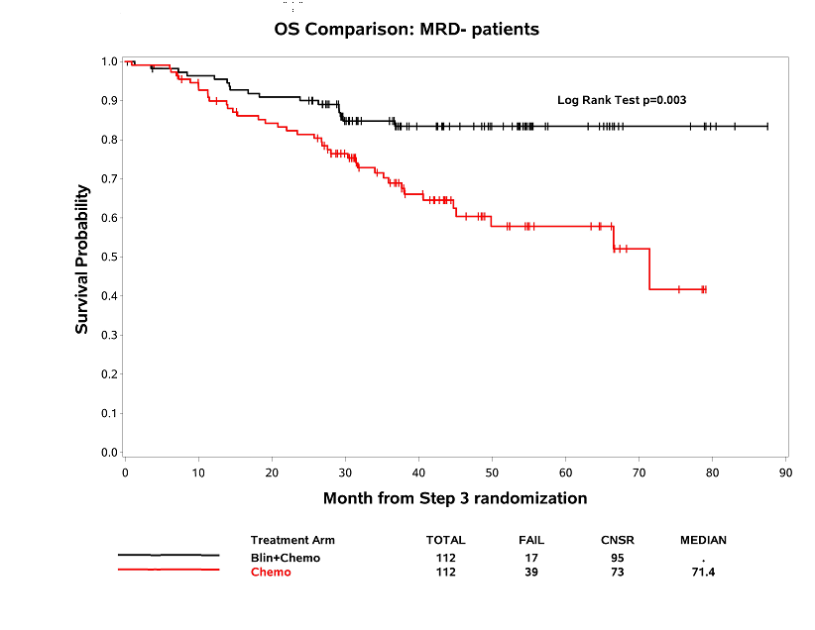
Overall Survival Comparison: MRD negative patients
Median OS: not reached (Blin+Chemo) vs 71.4 mos (Chemo); Hazard ratio 0.42, 95% CI: 0.24-0.75;
Log rank test, p=0.003
Deaths on Blin+Chemo Arm=17 (2° to ALL=8, NRM=9), Chemo Arm=39 (2° to ALL=20, NRM=17, Unknown=2
Reproduced with permission from Litzow MR, et al. Presented at: American Society of Hematology Annual Meeting; December 10-13, 2022; New Orleans, LA, USA.

Slide 10
Relapse-Free Survival Comparison: MRD negative patients
Median RFS: not reached (Blin+Chemo) vs. 22.4 months (Chemo); Hazard ratio 0.46, 95% CI: 0.27 – 0.78; Log rank test, p=0.004
Reproduced with permission from Litzow MR, et al. Presented at: American Society of Hematology Annual Meeting; December 10-13, 2022; New Orleans, LA, USA.

Slide 11
Overall Survival Comparison: MRD positive patients
Median OS: not reached (Blin + Chemo) vs. 22.4 months (Chemo); Hazard ratio 0.39, 95% CI: 0.14-1.10; Log rank, p=0.066
Deaths on Blin + Chemo Arm=9 (2° to ALL=6, NRM=1, Unknown=3), Chemo Arm=13 (2° to ALL=7, NRM=6)
Reproduced with permission from Litzow MR, et al. Presented at: American Society of Hematology Annual Meeting; December 10-13, 2022; New Orleans, LA, USA.

Slide 12
Conclusions
In the phase III randomized ECOG-ACRIN & NCTN trial E1910, consolidation with blinatumomab combined with chemotherapy has shown for the first time an overall survival advantage for adult patients with MRD-negative BCR::ABL negative B lineage acute lymphoblastic leukemia
The combination was in general well tolerated with no new safety signals reported
These results represent a new standard of care for this group of patients
Reproduced with permission from Litzow MR, et al. Presented at: American Society of Hematology Annual Meeting; December 10-13, 2022; New Orleans, LA, USA.

Slide 13
ACKNOWLEDGMENTS
Elisabeth Paietta, PhD; MRD studies
Zhuoxin Sun, PhD, statistician
Yanming Zhang, MD; cytogeneticist
Ryan Mattison, MD; study co-chair
Martin Tallman, MD; committee chair
Selina Luger, MD; committee co-chair
M. Wieduwilt, MD; M. Liedtke, MD; J. Bergeron; Alliance, SWOG & CCTG co-chairs, resp.
Gerhard Zugmaier, MD and colleagues at Amgen
NCTN colleagues who accrued to the study
Patients and Families
Reproduced with permission from Litzow MR, et al. Presented at: American Society of Hematology Annual Meeting; December 10-13, 2022; New Orleans, LA, USA.

